Slide 1
Uber Project
Made by: - Hetul Chaudhary
Rohan Amlani
Seemant Chandel
Manik Bakshi

Slide 2
Topics :-
Frameworks :
Spring boot
Database :
H2 Database
Dependencies
Tools
API
Design Patterns
Design structure

Slide 3
What is Spring Boot ?
It’s a tool which is used for making Java Programs.
Spring Boot is an open-source Java-based framework primarily aimed at simplifying and accelerating the process of creating stand-alone, production-grade Spring-based applications.

Slide 4
Why Spring Boot ?
Spring Boot automatically configures applications based on their dependencies, reducing manual setup.
It reduces the amount of configuration and setup needed to start a new project. Instead of spending time setting up servers and libraries, developers can jump straight into coding.

Slide 5
H2 Database
H2 database is a lightweight, open-source relational database management system written in Java. It's designed for embedded use in Java applications or in-memory databases. Despite being lightweight, it offers features similar to other relational database systems like transactions, clustering, and MVCC (Multi-Version Concurrency Control).

Slide 6
Dependencies
Lombok
Jackson data format XML
Tomcat
Spring boot security
Jason web token
Java Persistence API

Slide 7
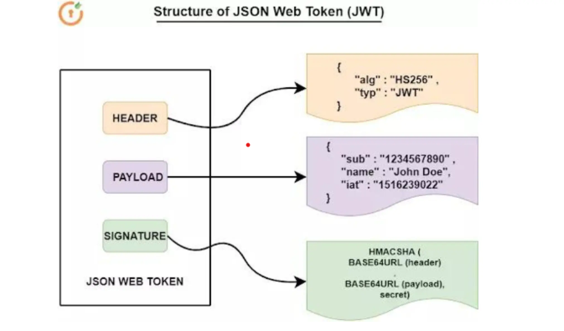
Json web token
It's commonly used for securely transmitting data between a client and a server as a URL-safe string.
JWTs are often used for authentication and authorization purposes in web applications. After a user logs in, a JWT containing user information (such as user ID and role) is generated by the server and sent to the client.

Slide 8
Google distance API
The Google Distance Matrix API is a service provided by Google Maps Platform that calculates travel distance and journey duration between multiple origins and destinations. It allows developers to integrate distance and duration calculations into applications, enabling features such as route planning, location-based services, and logistics optimization.

Slide 9
Tools :
Post Man
Build tool
Maven

Slide 10
Design patterns :
Builder Design Patterns
Factory Design Patterns
Singleton Design Patterns
Chain of Responsibility

Slide 11
MVC
Design Architecture Pattern :
MVC stands for Model-View-Controller, which is a software architectural pattern commonly used in designing web applications. It separates an application into three interconnected components, each with its own distinct responsibility:

Slide 12
Thank you

